Slide 1
Shared Objects and Mutual Exclusion
Concurrent Programming CT074-3-2 Version 0120

Slide 2
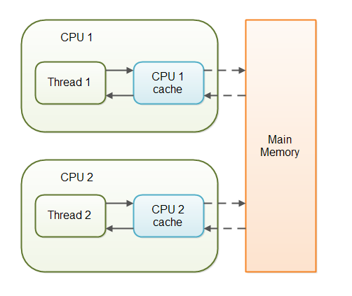
volatile

Slide 3
Exercise
Modify the Thread in week 2 to create 4 threads. Using thread priority, give thread 4 the highest priority. Adjust the program to make Thread 4 exit first before any other threads start.
Week 2 – RunnableThread OR ThreadExtend

Slide 4
join() method
Modify the Thread in week 2 to create 4 threads. Using thread priority, give thread 4 the highest priority. Adjust the program to make Thread 4 exit first.
Week 2 – RunnableThread OR ThreadExtend

Slide 5
Topic & Structure of The Lesson
Interference
Interleaving

Slide 6
Learning Outcomes
At the end of this topic, You should be able to
Describe shared objects and mutual exclusion
Explain how interference and interleaving impacts concurrent threads.
Discuss issues involved in interleaving

Slide 7
Key Terms You Must Be Able To Use
If you have mastered this topic, you should be able to use the following terms correctly in your assignments and exams:
Interference
Interleaving

Slide 8
Shared Objects & Mutual Exclusion
Concepts
process interference
mutual exclusion
Practice
thread interference in shared Java objects
mutual exclusion in Java (synchronized objects/methods).

Slide 9
Shared Objects & Mutual Exclusion - Overview
So far we have looked at:
execution of multiple processes on one or more processors,
Modeling concurrent execution by interleaving and
Executing multiple concurrent threads in a Java program.
We have looked at how process interactions is modeled using shared atomic actions, but not how real processes or threads interact.

Slide 10
Shared Objects & Mutual Exclusion - Overview
We will now look at issues involved in constructing concurrent programs in which threads interact to communicate and cooperate.

Slide 11
Interference
Case Study: Ornamental garden problem:
People enter an ornamental garden through either of two turnstiles. Management wishes to know how many are in the garden at any time.
The concurrent program consists of two concurrent threads and a shared counter object.

Slide 12
Ornamental garden Program - class diagram
The Turnstile thread simulates the periodic arrival of a visitor to the garden every second by sleeping for a second and then invoking the increment() method of the counter object.

Slide 13
Ornamental garden program
The Counter object and Turnstile threads are created by the go() method of the Garden applet:
private void go()
{
counter = new Counter(counterD);
west = new
Turnstile(westD,counter);
east = new
Turnstile(eastD,counter);
west.start();
east.start(); }

Slide 14
Turnstile class
The run() method exits and the thread terminates after Garden.MAX visitors have entered.
class Turnstile extends Thread {
NumberCanvas display;
Counter people;
Turnstile(NumberCanvas n,Counter c)
{ display = n; people = c; }
public void run() {
try{
display.setvalue(0);
for (int i=1;i<=Garden.MAX;i++){
Thread.sleep(500); //0.5 second between arrivals
display.setvalue(i);
people.increment();
}
} catch (InterruptedException e) {}
}
}

Slide 15
Counter class
Hardware interrupts can occur at arbitrary times.
The counter simulates a hardware interrupt during an increment(), between reading and writing to the shared counter value. Interrupt randomly calls Thread.sleep() to force a thread switch.
class Counter {
int value=0;
NumberCanvas display;
Counter(NumberCanvas n) {
display=n;
display.setvalue(value);
}
void increment() {
int temp = value; //read value
Simulate.HWinterrupt();
value=temp+1; //write value
display.setvalue(value);
}
}

Slide 16
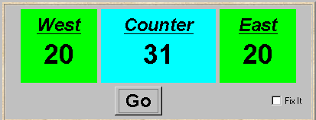
Ornamental garden program - display

Slide 17
Group Discussion
After the East and West turnstile threads have each incremented its counter 20 times, the garden people counter is not the sum of the counts displayed. Counter increments have been lost. Why?

Slide 18
Summary
- The simple model of interleaving is insufficient to resolve complexities in constructing concurrent programs

Slide 19
Learning Outcomes
At the end of this module, you should be able to do the following:
Discuss the concept of interference.
Describe the process of mutual exclusion.
Check model for interference.
Model mutual exclusion.
Perform mutual exclusion in Java using synchronised method/object.

Slide 20
Ornamental garden program - display
After the East and West turnstile threads have each incremented its counter 20 times, the garden people counter is not the sum of the counts displayed. Counter increments have been lost. Why?

Slide 21
Concurrent method activation
Java method activations are not atomic - thread objects east and west may be executing the code for the increment method at the same time.
west
east
shared code
PC
PC
increment:
read value
write value + 1
program
counter
program
counter

Slide 22
Interference and Mutual Exclusion
Destructive update, caused by the arbitrary interleaving of read and write actions, is termed interference.
Interference bugs are extremely difficult to locate. The general solution is to give methods mutually exclusive access to shared objects. Mutual exclusion can be modeled as atomic actions.
Notes:
Mutual exclusion (often abbreviated to mutex) algorithms are used in concurrent programming to avoid the simultaneous use of a common resource, such as a global variable, by pieces of computer code called critical sections.
Examples of such resources are fine-grained flags, counters or queues, used to communicate between code that runs concurrently, such as an application and its interrupt handlers. The problem is acute because a thread can be stopped or started at any time.
To illustrate: suppose a section of code is altering a piece of data over several program steps, when another thread, perhaps triggered by some unpredictable event, starts executing. If this second thread reads from the same piece of data, the data, in the process of being overwritten, is in an inconsistent and unpredictable state. If the second thread tries overwriting that data, the ensuing state will probably be unrecoverable. These critical sections of code accessing shared data must therefore be protected, so that other processes which read from or write to the chunk of data are excluded from running.
A mutex is also a common name for a program object that negotiates mutual exclusion among threads, also called a lock.

Slide 23
Mutual exclusion in Java
Concurrent activations of a method in Java can be made mutually exclusive by prefixing the method with the keyword synchronized, which uses a lock on the object.
We correct COUNTER class by deriving a class from it and making the increment method synchronized:
class SynchronizedCounter extends Counter {
SynchronizedCounter(NumberCanvas n)
{super(n);}
synchronized void increment() {
super.increment();
}
}
acquire lock
release lock

Slide 24
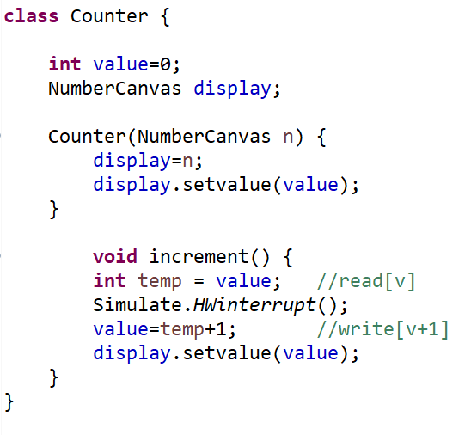

Slide 25
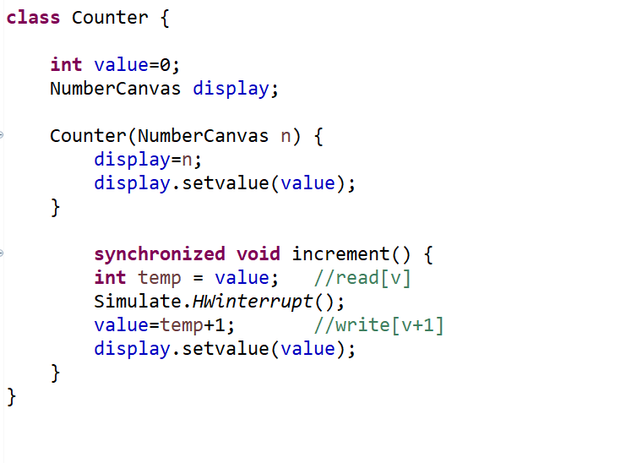

Slide 26

Monitor

Slide 27
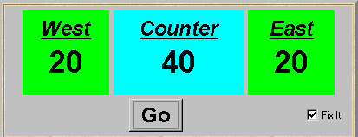
Mutual Exclusion - the ornamental garden
Java associates a lock with every object. The Java compiler inserts code to acquire the lock before executing the body of the synchronized method and code to release the lock before the method returns. Concurrent threads are blocked until the lock is released.

Slide 28
Java synchronized statement
Access to an object may also be made mutually exclusive by using the synchronized statement:
synchronized (object) { statements }
A less elegant way to correct the example would be to modify the Turnstile.run() method:
synchronized(people) {people.increment();}
To ensure mutually exclusive access to an object, all object methods should be synchronized.
Why is this “less elegant”?
Notes:
This is less elegant as the user of the shared object (Turnstile.run) has the responsibility for imposing the lock, rather than embedding it in the shared object itself (Counter) . Since not all users of the object may act responsibly, it may also be less secure against interference. Better to embed the lock in the object itself, rather than trusting all users will lock it properly.
Once a thread has acquired the lock on an object by executing a synchronized method, that method may itself call another synchronized method from the same object (directly or indirectly) without having to wait to acquire the lock again. The lock counts how many times it has been acquired by the same thread and does not allow another thread to access the object until there has been an equivalent number of releases. This locking strategy is sometimes termed recursive locking since it permits recursive synchronized methods.
For example:
public synchronized void increment(int n) {
if (n>0) {
++value;
increment(n-1);
}
else return;
}
This is a rather unlikely recursive version of a method which increments value by n. If locking in Java was not recursive, it would cause a calling thread to be blocked forever, waiting to acquire a lock which it already holds!

Slide 29
This is less elegant as the user of the shared object (Turnstile.run) has the responsibility for imposing the lock, rather than embedding it in the shared object itself (Counter).
Since not all users of the object may act responsibly, it may also be less secure against interference.
Better to embed the lock in the object itself, rather than trusting all users will lock it properly.

Slide 30
Summary
Concepts
process interference
mutual exclusion
Practice
thread interference in shared Java objects
mutual exclusion in Java (synchronized objects/methods).

Slide 31
Lab summary
Explain Priority.java
https://app.sli.do/event/b5adwesc

Slide 32
What we will cover next
Monitors and conditional synchronisation

Slide 33
References
Jeff M & Jeff K, Concurrency – State Models & Java Programming

Slide 34
Q & A

Slide 35
Ornamental Garden
Modify the uncorrected version of the Ornamental Garden program to implement the SynchronizedCounter as stated in the lecture slides.
Garden.java
NumberCanvas.java

Slide 36
Car Park
Run the Car Park program. Change NotifyAll to Notify.
Explain what happens to your tutor.
Add another 2 arrival threads. Change Notify to NotifyAll.
Explain what happens to your tutor

Slide 37
Labelling
Myvi Accessed Gate 1
Myvi Accessed Gate 2
Ferrari Accessed Gate 1
Ferrari Accessed Gate 2
Bugatti Accessed Gate 1
Bugatti Accessed Gate 2
Nissan Accessed Gate 1
Nissan Accessed Gate 2

Slide 38
What we will cover next
Classical problems

Slide 39
Doctor and Patient

